Slide 1
Exam Experience

Slide 2
About the Exam
Multiple-Choice Questions
Longer, scenario-based questions
Hands-On Lab Scenarios
Read a scenario, configure Vault as required
Hybrid Scenarios
Read a scenario, look at Vault to determine the answer and select the proper answer from multiple-choice

Slide 3
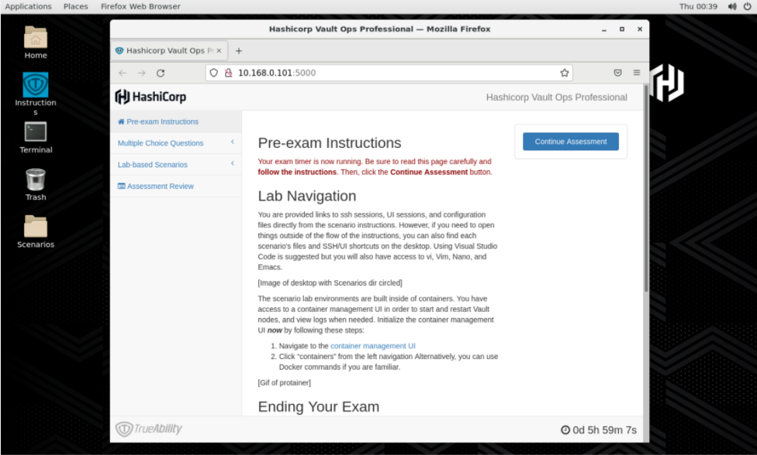
Exam Experience
All assessments are done via browser in the virtual desktop
Hybrid Questions are under the Lab-Based Scenarios
You can use Firefox to access Vault documentation
*Screenshot from HCVOP Study Guide

Slide 4
Multiple-Choice
Your organization is running Vault Enterprise for production workloads. Due to high workloads, your production cluster is cannot keep up with the number of reads requests. As a result, applications are displaying errors to customers and the business is at risk of losing significant revenue.
How can you reconfigure the Vault cluster to provide scale-out read capabilities without taking an outage on any of the Vault cluster nodes?
Increase the memory for each node by changing the underlying hardware
Determine the secrets engine being overused and enable multiple secrets engines to spread the workload across them
Reconfigure the load balancer with another listener, point it to the performance standby nodes, and reconfigure read-only applications to send request to the new listener
Deploy another Vault cluster and configure disaster recovery replication. Redirect some clients to the new cluster.
Answer: C

Slide 5
Hybrid Question
You are the Vault engineer at your organization. A user recently stated they cannot log in to Vault and interact with the proper Namespace assigned to their team. Based on the policies that are already created in Vault, determine which policy permits them to authenticate to the root namespace and interact with the namespace called mobile-team-a.
Click HERE to open an SSH session to the Vault cluster node. Determine the correct policy to use and select the answer below.
operation-policy
automation-ro-policy
training-team-policy
developer-team-a-policy
TERMINAL
Welcome to the Vault cluster.
$
Answer: C

Slide 6
Lab-Based Scenarios
There are MANY grading opportunities throughout the test, meaning that you will get partial credit for doing some things correctly even if others are incorrect
Validate your configurations/answers
Run a cat /grading/scenario1/node-a.json to view the file
Log in as a user your created to validate it works and the correct config is there
Some tasks build on others, so you'll need to complete each scenario in order:
Create a Vault configuration file
Start Vault
Initialize Vault

Slide 7



Lab-Based Scenarios
Example Scenario
Initialize a Vault node using Integrated Storage
Demonstrate you can create a Vault server configuration file
Know how to configure Auto Unseal
Set up an HA cluster
Initialize a Vault server using production hardening techniques
Vault Config
node-a
Start/Initialize
*Information from Study Guide

Slide 8

Lab-Based Scenarios
Example Scenario
Vault Agent and Templating
Set up a Vault Agent to authenticate to Vault (Vault Agent Auth-Auth)
Retrieve Secrets (Vault Agent Templates)
Vault Agent
Auto-Auth
Templating
app-a
node-a
*Information from Study Guide

Slide 9
Lab-Based Scenarios
Example Scenario
Vault Enterprise Replication
Enable and Configure DR Replication and Performance Replication
Know how to configure a paths filter
Replication
Paths Filter
node-a
node-b
*Information from Study Guide

Slide 10
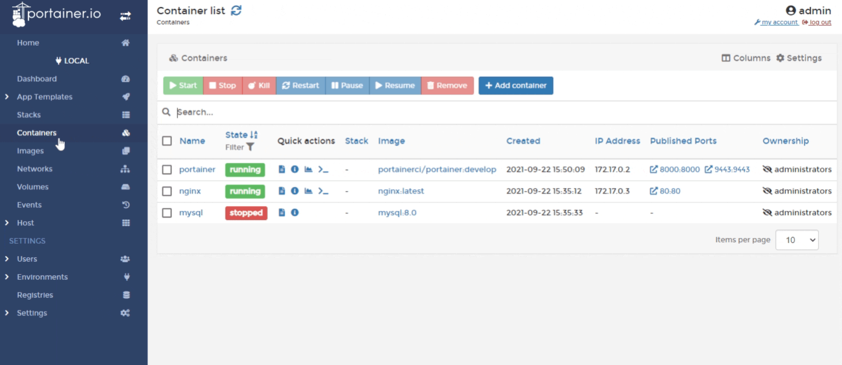
Using Portainer
Needed for some Lab-Based Scenarios
2. Choose Action
1. Select Container
*Screenshot from docs.portainer.io

Slide 11
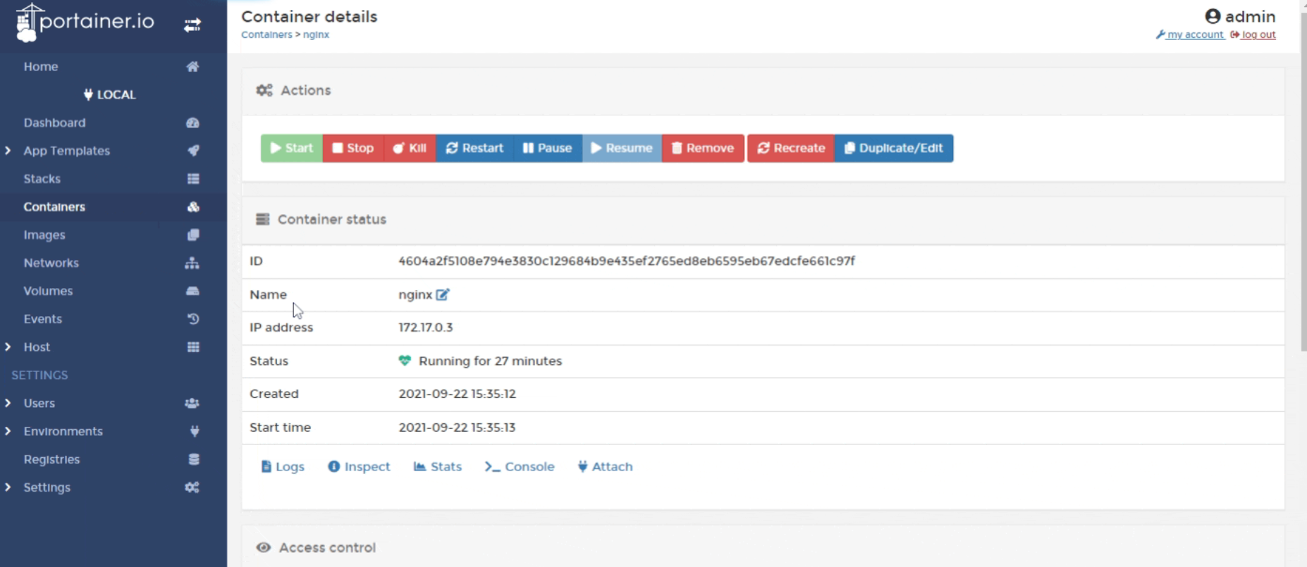
Using Portainer
Needed for some Lab-Based Scenarios
1. Click Container
2. Click Logs
*Screenshot from docs.portainer.io

Slide 12
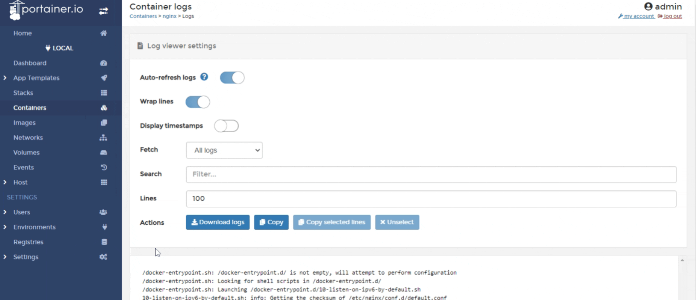
Using Portainer
Needed for some Lab-Based Scenarios
View Logs Here
*Screenshot from docs.portainer.io

